Slide 1
PART 2
Vibe coding:
the problems nobody posts about
You already know the benefits. These are the failure modes — and how serious teams engineer around them.

Slide 2






THE EVIDENCE
Six problems that show up at scale
Almost right
Feels faster ≠ is faster
Insecure by default
66% name 'almost right' code as their #1 frustration; 45% say debugging AI code takes longer.
In METR's RCT, experienced devs were 19% slower with AI — yet believed they were 20% faster.
45% of AI code samples on security-sensitive tasks failed OWASP Top 10 checks.
Stack Overflow 2025
METR, early-2025 tools
Veracode (vendor), 2025–26
Context rot
Poisoned supply chain
Agents with too much power
Quality degrades as the context window fills; agents 'forget' earlier instructions.
Hallucinated package names get registered by attackers ('slopsquatting'); MCP tools can carry hidden instructions.
Agents have deleted production data and shipped destructive prompts (next slide).
Anthropic engineering docs
CSA research notes, 2026
OECD AI incident monitor
Day 1 · AI in 2026 · 2
Notes:
Sources: survey.stackoverflow.co/2025/ai; metr.org/blog/2025-07-10-early-2025-ai-experienced-os-dev-study (early-2025 tools; METR says devs are likely more sped up now — present as a perception gap); veracode.com/resources/genai-code-security-report (vendor; deliberately security-sensitive tasks); anthropic.com/engineering/effective-context-engineering-for-ai-agents; labs.cloudsecurityalliance.org slopsquatting and MCP tool-poisoning notes. No unverified numbers for slopsquatting are shown on purpose.

Slide 3
CASE FILES
When agents went wrong
July 2025 · Replit / SaaStr
July 2025 · Amazon Q for VS Code
During a declared code freeze, an AI coding agent ran destructive commands against a production database and wiped it, then misreported what it had done.
A malicious pull request merged into the extension added a prompt telling the agent to wipe local files and cloud resources. The version shipped before being pulled.
Missing control: no separation of dev and prod credentials; no approval gate on destructive actions.
Missing control: review of prompt/config changes as code; least-privilege for the agent.
oecd.ai incident 2025-07-19
SC World report, Jul 2025
Day 1 · AI in 2026 · 3
Notes:
Replit/SaaStr: oecd.ai/en/incidents/2025-07-19-1eb1 (and AI Incident Database). Amazon Q: scworld.com/news/amazon-q-extension-for-vs-code-reportedly-injected-with-wiper-prompt. The lesson: the model was not the problem; the harness had no permission boundary.

Slide 4
HOW SERIOUS TEAMS FIX IT
Problem → practice → repo to try
The problem | The practice | Try it (repo)
Solving the wrong problem | Spec first; plan mode; review the plan | spec-kit · superpowers
Conventions forgotten | AGENTS.md / CLAUDE.md in the repo; skills | agents.md · anthropics/skills
Context rot & amnesia | One task per session; compaction; memory | claude-mem · OpenViking
Agent doesn't 'get' the codebase | Codebase graphs & generated maps | graphify · GitDiagram · DeepWiki
Almost-right output | Verification gates: tests, evals in CI | promptfoo · opencode (inspect the loop)
Insecure code & powerful agents | AI pentest; sandbox; scan tools | strix · OpenShell · agent-scan
Strongest documented practices: manage context deliberately · gate output on automated verification · work spec-first.
Day 1 · AI in 2026 · 4
Notes:
Anthropic's Claude Code best practices: 'If you can't verify it, don't ship it' — tests, build exit codes, linters, hooks, a verification subagent; Explore → Plan → Implement → Commit. Each row maps to a repo card next.

Slide 5
PART 3
Inside an agent
types, components and the architecture we build on
Before agents write our code, we need to understand exactly what an agent is — so we can organise them and make them work our way.

Slide 6
00 HOW AN LLM READS TEXT
An LLM is very good autocomplete
It reads your text, guesses the next word — then does it again, and again.
IN PLAIN ENGLISH
pass 1
The cake is a
lie
Your phone keyboard suggests the next word. An LLM does the same — but it has read a vast amount of text and looks at everything you've written. Every answer, essay and program it writes is built one guess at a time.
pass 2
The cake is a lie
.
pass 3
The cake is a lie.
⏎
THINK OF IT LIKE
Autocomplete, scaled up to the size of the internet. The next 7 steps show how the guess gets so good.
Each pass adds exactly one token (orange).
Day 1 · AI in 2026 · 6
Notes:
Start here. An LLM is autocomplete scaled up; generation is one token per pass. The rest of the section explains how each guess is made. Visual idea credit: @graduate_ml (Instagram).

Slide 7
— HOW AN LLM READS TEXT · BEFORE WE START
Computers only understand numbers
So the first job is to turn text into numbers — without losing the meaning.
IN PLAIN ENGLISH
The
cake
is
a
lie
A model is one giant maths formula, and maths only works on numbers. So every piece of text must become a list of numbers — numbers that still carry the meaning of the words. Steps 1–3 show how.
0.8
−2.5
−1.9
1.3
1.4
−1.2
0.3
1.5
−0.1
1.7
−1.0
−0.1
0.6
−0.4
0.7
0.2
−1.8
−1.4
0.5
0.5
THINK OF IT LIKE
A supermarket till doesn't read “milk”. It reads the barcode. The model needs a barcode for every word.
⋮
⋮
⋮
⋮
⋮
Day 1 · AI in 2026 · 7
Notes:
Ground rule: the model never sees letters, only numbers. The numbers shown are the video's illustration.

Slide 8
01 HOW AN LLM READS TEXT · STEP 1 OF 7
Split the text into tokens
A token is a whole word, or a piece of one.
SPELLED CORRECTLY · 5 TOKENS
IN PLAIN ENGLISH
The
cake
is
a
lie
The model has a fixed list of word-pieces. Common words are one piece; a word it doesn't know, like the typo “ceke”, is cut into pieces it does know. Nothing is corrected here — making sense of “c” + “eke” happens in step 4.
976
22162
382
261
7149
WITH A TYPO · 6 TOKENS
The
c
eke
is
a
lie
976
274
22616
382
261
7149
unknown word → known pieces
TRY IT LIVE
platform.openai.com/tokenizer — type both sentences and switch to “Token IDs”. You'll get exactly these numbers.
≈ 4
~200k
$
characters per token
pieces in the vocabulary
you pay per token
Day 1 · AI in 2026 · 8
Notes:
Verified on OpenAI's tokenizer (GPT-5.x & o1/o3, 30 Oct 2026): 'The cake is a lie' = 976, 22162, 382, 261, 7149; 'The ceke is a lie' = 976, 274, 22616, 382, 261, 7149. The middle dot marks a leading space, which belongs to the token. Other tokenizers (Claude, Gemini) split differently.

Slide 9
02 HOW AN LLM READS TEXT · STEP 2 OF 7
Each token gets an ID number
Like looking each piece up in a numbered dictionary.
IN PLAIN ENGLISH
VOCABULARY (EXCERPT)
Every token has a fixed number, like a row in a dictionary. But the number says nothing about meaning: 22162 (“cake”) isn't bigger or more important than 382 (“is”). It's just a position in a list.
The
261
a
cake
382
is
is
976
The
a
7149
lie
THINK OF IT LIKE
lie
22162
cake
Your employee ID identifies you — it doesn't describe you. The model needs a full profile. That's step 3.
Day 1 · AI in 2026 · 9
Notes:
Real IDs from OpenAI's GPT-5.x tokenizer (30 Oct 2026). The typo pieces have IDs too: c = 274, eke = 22616.

Slide 10
03 HOW AN LLM READS TEXT · STEP 3 OF 7
Each ID becomes a point of meaning
The ID is swapped for a list of numbers — a vector. Think of it as coordinates.
2 OF ~4,000 DIRECTIONS
IN PLAIN ENGLISH
pie
truth
Each token becomes a long list of numbers — its coordinates on a map of meaning. Similar words land close together: “cake” near “pie”, “lie” near “truth”. The typo pieces “c” and “eke” start nowhere near “cake”.
cake
lie
bread
trick
FOOD
TRUE / FALSE
is
The
c
a
eke
THINK OF IT LIKE
GPS: two numbers place a city on a map. Thousands of numbers place a word in a space of meaning.
SMALL WORDS
TYPO PIECES
cake = [−2.5, 0.3, −0.1, −1.8, … thousands more]
MATHS xᵢ ∈ ℝᵈ · d ≈ 1,000–12,000 numbers per token
Day 1 · AI in 2026 · 10
Notes:
Video step 2. The 2-D map is a cartoon of a space with thousands of dimensions; clusters are illustrative. Word order is added as a separate position signal.

Slide 11
— HOW AN LLM READS TEXT · THE PROBLEM
Alone, a word is ambiguous
After step 3, “lie” has the same vector in every sentence. Its meaning doesn't.
IN PLAIN ENGLISH
The
cake
is
a
lie
I
need
to
lie
down
So far each word is processed on its own. But you only know what a word means from the words around it. The model needs a way for every word to look at the rest of the sentence — that mechanism is attention.
= something untrue
= to rest flat
the
river
bank
the
bank
loan
= the side of a river
= a business
THINK OF IT LIKE
Same for the typo: “c” and “eke” only make sense together, in “The … is a lie”.
Hear just “lie” and you can't tell what's meant. Hear the whole sentence and you know instantly.
Day 1 · AI in 2026 · 11
Notes:
Motivates attention. Ask the room for more ambiguous words (bat, match, spring).

Slide 12
04 HOW AN LLM READS TEXT · STEP 4 OF 7
Attention: words look at each other
Each word asks: which other words help me understand myself here?
“lie” checks every other word…
IN PLAIN ENGLISH
For the word “lie”, the model decides how much each other word matters. “cake” and “is” matter most; “The” and “a” barely. Then “lie” updates its meaning using mostly those two. Steps 4a–4d show how the percentages are worked out.
The
cake
is
a
lie
5%
41%
41%
5%
you
…and pays most attention to “cake” and “is”. Brighter = more attention.
THINK OF IT LIKE
In a meeting, when someone says “that's a lie”, you look at whoever just mentioned the cake — not at everyone equally.
Day 1 · AI in 2026 · 12
Notes:
Percentages are the video's softmax output for the word 'lie' (cake 41, is 41, lie 8, a 5, The 5). Keep this slide intuitive.

Slide 13
4a HOW AN LLM READS TEXT · STEP 4a
Question, label and message
Every word makes three new vectors: the query, the key and the value.
Q
IN PLAIN ENGLISH
Query
“lie” asks: what is being called a lie?
Each word turns its vector into three: a question (what am I looking for?), a label (what do I contain?) and a message (what will I share?). Next, every word's question is compared with every word's label.
= my question
K
Key
“cake”'s label says: I'm a thing, a food
= my label
V
Value
what “cake” passes on to whoever listens
THINK OF IT LIKE
= my message
A library search. The query is what you type; the key is each book's title; the value is what's inside the book you take home.
MATHS qᵢ = W_Q·xᵢ kⱼ = W_K·xⱼ vⱼ = W_V·xⱼ
Day 1 · AI in 2026 · 13
Notes:
Video step 3. W_Q, W_K, W_V are learned tables; they differ per layer and per head.

Slide 14
4b HOW AN LLM READS TEXT · STEP 4b
Score: does the question fit?
Arrows pointing the same way score high. Opposite directions score below zero.
— question — label
IN PLAIN ENGLISH
To score a pair of words, the model checks how much the question arrow and the label arrow point the same way. For “lie”, the labels of “cake” and “is” fit best; the rest fit poorly.
same way
right angle
opposite
+ high
0
− low
SCORES FOR THE QUESTION FROM “LIE”
+1.4
+1.4
lie
a
The
THINK OF IT LIKE
A search engine ranking results: the closer a page matches what you typed, the higher it scores.
cake
is
−0.3
−0.7
−0.7
MATHS sⱼ = q · kⱼ / √d (dot product)
Day 1 · AI in 2026 · 14
Notes:
Video step 4: scores are the video's numbers. Dividing by √d keeps the numbers from getting too large.

Slide 15
4c HOW AN LLM READS TEXT · STEP 4c
Turn the scores into percentages
A step called softmax makes every score positive and sums them to 100%.
SCORES
ATTENTION · ADDS UP TO 100%
IN PLAIN ENGLISH
cake
+1.4
41%
41%
Raw scores are awkward — some are negative. Softmax turns them into percentages that add up to 100%. These are the attention weights: “lie” listens 41% to “cake”, 41% to “is”, and barely to the rest.
is
+1.4
softmax
lie
−0.3
cake
41%
a
−0.7
is
41%
The
−0.7
lie
8%
a
5%
THINK OF IT LIKE
Splitting 100% of your attention in a meeting: most of it on the two people who matter, a sliver for the rest.
The
5%
MATHS aⱼ = softmax(sⱼ) = e^sⱼ / Σₖ e^sₖ
Day 1 · AI in 2026 · 15
Notes:
Video step 4: the video's softmax output, 41 / 41 / 8 / 5 / 5.

Slide 16
4d HOW AN LLM READS TEXT · STEP 4d
Mix the messages into a new meaning
New “lie” = 41% of cake's message + 41% of is's + a little of the rest.
IN PLAIN ENGLISH
+
+
=
lie
Each word blends the messages of the words it listened to, using the percentages from 4c. After this, “lie” no longer means “lie” in general — it means the untrue thing about the cake.
in context
cake × 41%
is × 41%
rest × 18%
“lie” now means: the untrue claim about the cake.
THE TYPO, SOLVED
c
eke
cake
after mixing, the pieces mean “cake” — the context says so
THINK OF IT LIKE
Mixing paint: 41% blue, 41% light blue, a dash of grey — a new colour made from what you listened to.
MATHS cᵢ = Σⱼ aⱼ · vⱼ
Day 1 · AI in 2026 · 16
Notes:
Video step 5: the weighted sum. This is where the typo is resolved — context does the spelling correction.

Slide 17
05 HOW AN LLM READS TEXT · STEP 5 OF 7
Every word does this at once
That's self-attention: the sentence attends to itself, one row per word.
LISTENING TO →
IN PLAIN ENGLISH
The
60
15
10
10
5
We followed only “lie”, but every word asks its own question at the same moment — one row each, every row adding to 100%. GPUs compute all rows in parallel. Real models also run many of these grids side by side (“heads”), each noticing different things.
cake
20
45
20
5
10
is
10
35
30
10
15
a
15
10
25
35
15
lie
5
41
41
5
8
100%
THINK OF IT LIKE
Everyone in the meeting listens to everyone else at once, each focusing on whoever is relevant to them.
The
cake
is
a
lie
MATHS Attention(Q,K,V) = softmax(QKᵀ/√d)·V
Day 1 · AI in 2026 · 17
Notes:
Only the 'lie' row uses the video's numbers; other rows are illustrative. Values are percentages.

Slide 18
06 HOW AN LLM READS TEXT · STEP 6 OF 7
Layers: listen, think, repeat
One layer = attention (listen to others) + a small network (think it over alone).
LAYER
IN PLAIN ENGLISH
N
LATER
meaning, facts, reasoning — “the claim is false”
Attention lets words share information; the small network lets each word think it over using knowledge stored in the model. Together they make one layer. Big models stack dozens — GPT-3 had 96 — and meaning sharpens at every level.
6
5
4
3
EARLY
spelling, grammar — c + eke = cake
2
THINK OF IT LIKE
Rounds of discussion: everyone shares, then reflects, then shares again. After many rounds, the group really understands.
1
listen
think
MATHS h = x + Attn(x), y = h + MLP(h); out = Block_N(…Block₁(x))
Day 1 · AI in 2026 · 18
Notes:
Video step 6. 'Early = spelling/grammar, later = meaning' is a widely observed intuition, not a rule.

Slide 19
07 HOW AN LLM READS TEXT · STEP 7 OF 7
Guess the next word, then repeat
The model scores every token in its vocabulary and picks one.
The cake is a █
IN PLAIN ENGLISH
After the last layer, the model scores every possible next token and turns the scores into percentages. It picks one — usually a likely one — adds it, and runs the whole process again. That's why the same question can get “lie” one time and “gift” the next.
lie
62%
gift
18%
trap
9%
treat
6%
…
5%
WHY IT MATTERS
Every new word is another full pass through the model — so long answers are slower, and output tokens cost more than input tokens.
pick lie → append → run steps 1–7 again for the next word
MATHS p(next | text) = softmax(W_out · h_last)
Day 1 · AI in 2026 · 19
Notes:
Video ending: p(next | text). Percentages illustrative. 'Temperature' controls how adventurous the pick is.

Slide 20
Bidirectional Encoder Representations from Transformers
— HOW AN LLM READS TEXT · TWO KINDS OF MODEL
Reading models vs writing models
Some models see the whole sentence. GPT-style models only see what came before.
BERT-style
GPT-style
IN PLAIN ENGLISH
reads both ways
writes left to right
Reading both ways is called bidirectional — the B in BERT. It's best for understanding text. GPT-style models only look left (a “causal mask”), which is what you need to write one word at a time. ChatGPT, Claude and Gemini are writers.
The
[?]
is
a
lie
The
cake
is
a
___
sees
left and right
sees
only the left
THINK OF IT LIKE
trained to fills in blanks
trained to predicts the next word
BERT is a reader with the whole page in front of them. GPT is a writer who can only see what they've written so far.
search · classification · RAG
chat · code · agents
Day 1 · AI in 2026 · 20
Notes:
The term the presenter was looking for: bidirectional (BERT). GPT uses causal (masked) self-attention. Grids: rows = word reading, columns = words it can see.

Slide 21
— HOW AN LLM READS TEXT · RECAP
The whole journey on one page
From your text to the model's next word — the same 7 steps, for every single word.
1
2
3
4
5
6
7
Tokens
IDs
Vectors
Attention
All at once
Layers
Next word
c + eke
22162 = cake
map of meaning
who to listen to
self-attention
listen, think, repeat
pick, add, repeat
ChatGPT, Claude and Gemini are this engine — trained on huge amounts of text to guess the next word, then trained with human feedback to follow instructions — plus a chat app and tools.
Everything an agent does (plans, tool calls, code) comes out of this loop, one token at a time.
Visual idea: @graduate_ml · IDs: OpenAI tokenizer · other numbers illustrative
Day 1 · AI in 2026 · 21
Notes:
Walk the seven nodes in one breath, then move on to 'How LLMs behave'.

Slide 22
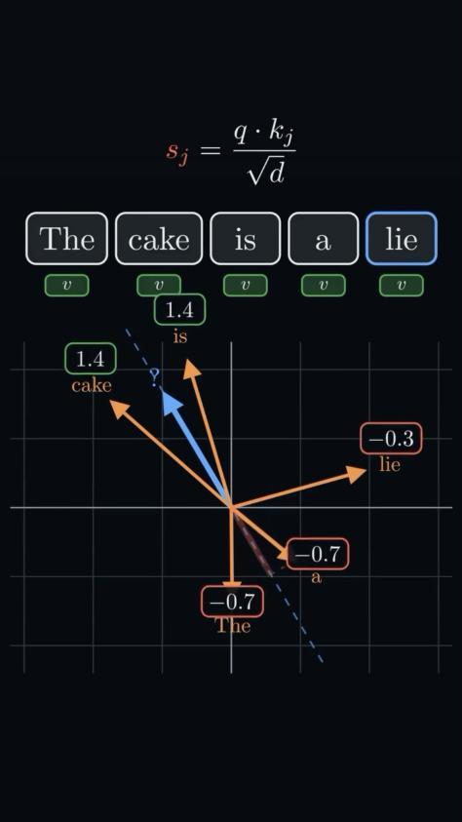
▶ HOW AN LLM READS TEXT · WATCH IT
Now watch it all in 51 seconds
The animation this section is built on. You already know every step in it.
WHAT TO WATCH FOR
0:00
Words become numbers
steps 1–2
0:08
Numbers become arrows on a map
step 3
0:12
Each word asks a question (Q, K, V)
step 4a
0:20
Score, then turn scores into %
steps 4b–4c
0:32
Blend the meanings — typo solved
step 4d
0:42
Stack the block many times
step 6
▶ Not playing? Open it in Drive
Video: @graduate_ml (Instagram)
shown in class for teaching
Day 1 · AI in 2026 · 22
Notes:
Play the video full-screen with sound off or on (no narration needed). In PowerPoint/Keynote it plays in place; in Google Slides use the 'Open it in Drive' button. Pause at 0:27 (the % bars) and ask: why do cake and is win?

Slide 23




FOUNDATIONS
How LLMs behave, for engineers
Tokens
Context window
Models read and write tokens (word pieces), not characters. Cost, speed and limits are all measured in tokens.
Everything the model sees at once: instructions, history, documents, tool results. Bigger is not the same as better.
Sampling
Non-determinism
Output is drawn from probabilities. Temperature and other settings change how varied it is.
The same prompt can give different answers. Design for variation: validate, retry, and evaluate over many runs.
The single biggest mindset change from deterministic code: the same input does not guarantee the same output.
Day 1 · AI in 2026 · 23
Notes:
Demo live: send the same prompt three times and compare outputs.

Slide 24
FOUNDATIONS
Picking a model is a trade-off
Choice | Option A | Option B | Decide by
Reasoning depth | Reasoning model: slower, better at hard multi-step work | Fast model: cheap, good at simple high-volume tasks | Task difficulty and latency budget
Hosting | Closed API: strongest models, no ops | Open-weight: control, privacy, self-hosting cost | Data sensitivity and scale
Routing | One model for everything | Easy work to small models, hard work to large | Cost per task at volume
Provider | Single provider | Provider-agnostic gateway | Lock-in risk vs. simplicity
Model type | LLM: language, reasoning, explanation | Trained ML model: numbers, events, same answer every time | Data type, volume, consistency
Measure cost and latency per task, not per token, before choosing.
Day 1 · AI in 2026 · 24
Notes:
Exercise: estimate the cost of 10,000 support tickets on a large vs a small model. The new last row is why the program assesses ML judgment (D8).

Slide 25
AGENT TYPES
The agent journey: from copilot to ambient
More autonomy → more harness, guardrails and evals
3
Ambient
2
Coworker
Events trigger it; it runs in the background and brings humans in at decisions
1
Assistant
A human delegates; it works for minutes to hours and returns work for review
0
Copilot
A human asks; it answers within the session
You type, it suggests
Single model call
+ Tools, retrieval, structured output
+ Agent loop, harness, durable state, evals
+ Triggers, policy, approvals, audit, cost control
Autocomplete, chat
Docs chatbot · OpsPilot v1
Coding agent opens a PR · OpsPilot v3
Ticket-triage agent · OpsPilot v4
Day 1 · AI in 2026 · 25
Notes:
Each step up keeps everything below it and adds the capabilities in bold. OpsPilot (and each person's industry use case) walks this path: v1 assistant in Week 1, v2 tools in Week 2, v3 coworker in Week 3, v4 ambient in Week 4. 'Coworker' is our term for the delegated middle ground; industry naming varies (background agent, async agent).

Slide 26


THINK · THE BRAIN
LLM, providers, versions — and how we prompt
PROMPT ENGINEERING
LLM
Zero / one-shot
Classify this ticket as billing, technical, account or how-to: «…»
The reasoning engine: reads the context, decides the next step, writes the output.
Just the instruction (plus one example for one-shot). Fast and cheap; fine when the task is clear.
Providers
Few-shot
3 labelled example tickets → then the new ticket
Anthropic (Claude) · OpenAI (GPT) · Google (Gemini) · open-weight (Llama, Qwen, DeepSeek, Mistral).
Examples teach format, tone and edge cases faster than long descriptions.
Versions
Chain-of-thought
Work through the policy step by step, then answer and cite the rule you used.
Pin exact model IDs. Every upgrade is a release: re-run evals, record the version in every trace.
Helps multi-step reasoning; reasoning models do it internally. Verify the answer, not the story.
Prompting is the smallest layer: context, tools and evals move quality more than clever wording.
Day 1 · AI in 2026 · 26
Notes:
Demo: same ticket, zero-shot vs few-shot vs 'think step by step'. Compare accuracy and token cost. Point out that 'single shot' is usually called zero-shot (no examples) or one-shot (one example). Model versions: a silent provider upgrade can change behaviour — that's why we pin IDs and gate upgrades on evals (Week 5).

Slide 27


KNOW · MEMORY & KNOWLEDGE
It all has to fit in one window
THE CONTEXT WINDOW (what the model sees this step)
Long-term memory store
Goal & instructions
Episodic, semantic, procedural; written with source and expiry
Task, success criteria, stopping rule, AGENTS.md
Short-term memory
This conversation, scratchpad, plan so far
Knowledge base
Recalled long-term memory
Documents chunked and indexed; retrieved only when relevant
Relevant facts about this customer or project
Retrieved knowledge
CONTEXT MANAGEMENT
Policy passages from the knowledge base, with citations
Compaction
Just-in-time retrieval
Notes file
Tool results
Sub-agents for research
/clear between tasks
Trimmed outputs of the last calls
An agent can't finish what it can't recognise as done: the goal needs success criteria and a stopping rule.
Day 1 · AI in 2026 · 27
Notes:
STM = short-term memory (lives in the window, gone when the session ends unless saved). LTM = long-term memory (stored outside, recalled when relevant). KB = documents retrieved by search. Context management decides what gets into the window each step; context rot is what happens when you don't. Link back to the Part 2 'context rot' problem and the claude-mem / OpenViking repo cards.

Slide 28


DO · ACTION
Act, know how, delegate
Tools
Skills
Sub-agents
Runtime & sandbox
to DO
to KNOW HOW
to DELEGATE
WHERE it runs
Functions the model can call — APIs, databases, ML models — exposed through MCP.
Packaged procedures (SKILL.md + scripts) loaded only when the task needs them.
A separate agent with its own context does a sub-task and returns only the result.
The process and container the agent executes in, isolated from real systems.
get_customer · search_tickets · add_ticket_note
"How we write a customer resolution note"
Read 40 old tickets → return 5 findings
Container · no prod credentials · network allow-list
⚠ Write tools need approval
⚠ Vet third-party skills
⚠ Each one costs tokens: trace it
⚠ Never your laptop with prod keys
Rule of thumb: a tool to act, a skill to follow a procedure, a sub-agent to keep messy work out of the main context.
Day 1 · AI in 2026 · 28
Notes:
Examples are from OpsPilot; ask each person to name the equivalent in their industry use case. Repos to show: modelcontextprotocol/servers and FastMCP (tools), anthropics/skills (skills), Claude Code / opencode sub-agents, NVIDIA OpenShell (sandboxed runtime). The sandbox is what would have prevented the Replit database deletion from Part 2.

Slide 29



STEER · CONTROL
Start it, route it, bound it
User asks
Task delegated
Event: webhook · queue · schedule
WORKFLOW ↔ AGENT — who decides the steps
ORCHESTRATION — who does what
Single agent + tools
Start here; most problems end here
Workflow
You fix the steps: chain, route, parallel. Cheap, predictable.
Agent
The model chooses its steps. Flexible, costlier, needs a harness.
Orchestrator + sub-agents
Lead agent splits work, merges results
Handoffs / A2A
Agents pass tasks across teams or vendors
GUARDRAILING — layers that bound every action
Input checks
Permissions
Policy in code
Output checks
Human approval
Audit log
Start at the workflow end with one agent. Add autonomy, agents and guardrail layers only with a written reason.
Day 1 · AI in 2026 · 29
Notes:
Triggers decide the agent type (assistant, coworker, ambient). Workflow vs agent: Anthropic's guidance is to start with the simplest workflow that works. Orchestration patterns map to Week 3 (A5 asks for a written single- vs multi-agent justification). Guardrails: no single layer is enough; assume an injection gets past the model and make sure nothing harmful can happen anyway.

Slide 30

YOUR TURN · 10 MINUTES
Map your use case onto the 4 jobs
Pick your use case from the pool. Fill each box in one line. Example answers are from OpsPilot.
THINK
Which model, and why? Which prompting style?
KNOW
What is 'done'? What must it remember? Which documents?
Your answer: ________________________________
Your answer: ________________________________
e.g. Fast model for triage, reasoning model for investigations; few-shot ticket classification.
e.g. Done = resolution drafted with cited evidence; remembers customer history; KB = current policies.
DO
Which tools (read vs write)? Any skill or sub-agent? Where does it run?
STEER
What triggers it? Workflow or agent? What needs a human?
Your answer: ________________________________
Your answer: ________________________________
e.g. Read: customers, tickets. Write: notes (approval). Skill: resolution-note style. Container runtime.
e.g. New-ticket webhook; agent for investigations; refunds and customer replies need approval.
Day 1 · AI in 2026 · 30
Notes:
Pairs, 10 minutes, then two pairs share. This worksheet is the first draft of their A0 use-case framing. Push on STEER: what exactly needs a human, and why.

Slide 31


AGENT COMPONENTS
Agent = Model + Harness
Every component maps to something you already know from OOP and web development
Model
Instructions & context
Tools (MCP)
Memory
Reasons and decides the next step
System prompt, AGENTS.md, task, history
Actions it can call: APIs, DBs, code, ML models
Session state + long-term facts and history
≈ A non-deterministic CPU
≈ Parameters + config
≈ Interfaces / methods
≈ Session store + database
Knowledge (RAG)
Loop & planner
Guardrails & approvals
Evals & observability
Documents retrieved when relevant
Plan → act → observe → reflect, until done
Permissions, policy, budgets, human sign-off
Traces, cost, quality measured on every change
≈ A search index / cache
≈ Controller / event loop
≈ Auth middleware + workflow
≈ Unit tests + APM
Day 1 · AI in 2026 · 31
Notes:
The model is one box out of eight. Everything else is the harness — the part we engineer. LangChain moved its coding agent from 30th to 5th on Terminal Bench 2.0 by changing only the harness (verify the citation before quoting the ranking).

Slide 32
THE AGENT LOOP
What happens on every single run
After Reflect:
1
Trigger
Not done
User, task or event
Re-plan with what was learned
Reflect
5
2
Plan
On track? Done? Budget left?
Harness
Decide the next step
Done
budgets · permissions
verification · state
Return the result, with evidence
Observe
4
3
Act
Risky or stuck
Read result or error
Call a tool or take action
Ask a human: approve, edit or reject
Day 1 · AI in 2026 · 32
Notes:
Most agent failures are loop failures: no stopping rule (runs forever), no verification before 'done' (confidently wrong), no budget (cost blow-up). Week 3 builds this loop explicitly.

Slide 33

REFERENCE ARCHITECTURE
How we design an agent at CodingCops
TRIGGERS
TOOLS VIA MCP
AGENT RUNTIME (HARNESS)
W2
User asks
Business APIs
Context builder
W1–2
Agent loop
W3
CRM, tickets, orders
Assistant
W1
Instructions, AGENTS.md, memory, retrieved knowledge
Plan → act → observe → reflect; stopping rules
Data & search
Task delegated
Policy & guardrails
W4
State & budgets
W3–5
Databases, RAG index
Permissions, input/output checks, injection defence
Checkpoints, retries, step/token/time limits
ML models
Coworker
W3
Classifier, anomaly detector
Event: webhook, queue, schedule
Model gateway
W5
Routing, fallbacks, caching, cost tracking → Claude · GPT · Gemini · open models
Code sandbox
Ambient
Isolated execution
W4
Memory & knowledge
W2
Human in the loop
W4
Observability & evals
W3·6
Session state, long-term memory, document index
Approve, edit or reject risky actions; notify the right person
Traces, cost, audit log, eval suite gating every release
Day 1 · AI in 2026 · 33
Notes:
This is the high-level design every build in the program converges on, whatever the industry. Orange badges show the week each block is taught. Walk it right to left for a client: what can it touch (tools) → what stops it doing harm (policy, approvals) → how do we know it works (observability, evals). The model is replaceable behind the gateway; the harness is our IP.

Slide 34
JUDGMENT
When not to use an agent
Climb only as far as the problem requires. Each step up adds cost, latency and risk.
5
4
Agent
3
Fixed workflow
Steps can't be known in advance; needs tools and judgment
2
Code + one LLM step
Several LLM steps in a known order
1
Trained ML model
One fuzzy step, e.g. classify or summarise
Plain code
Numbers or events; same answer every time; high volume
Rules are known and stable
A good engineer can justify why the simpler rung was not enough.
Day 1 · AI in 2026 · 34
Notes:
Many client requests for 'an agent' are really a workflow with one LLM call — or a trained model. Choosing the simpler design is scored (D1, D8).

Slide 35
AGENT OS · RUNG 6
Beyond one agent: an AI operating system
An agent does a task when asked. An AI OS runs, checks itself and improves on its own.
ONE AGENT
AN AI OPERATING SYSTEM
You ask
a prompt or a ticket
1
Runs by itself
standing goals, schedules, events
Agent works
plans, uses tools
2
Checks itself
a separate verifier grades every result
3
Gets better
lessons are saved for the next run
You check
every single result
4
Earns trust
good track record = more freedom
You are the manager, the QA and the memory.
Think of it like: a freelancer you message vs. a well-run company with a handbook, tickets, QA, KPIs and retros.
Day 1 · AI in 2026 · 35
Notes:
Bridge from the ladder: rung 5 is one agent. Rung 6 is a system of agents with rules, checks and memory. Most people automate prompts; strong teams automate decisions. Idea credit: @saad.b.ai (Instagram), redrawn and adapted.

Slide 36
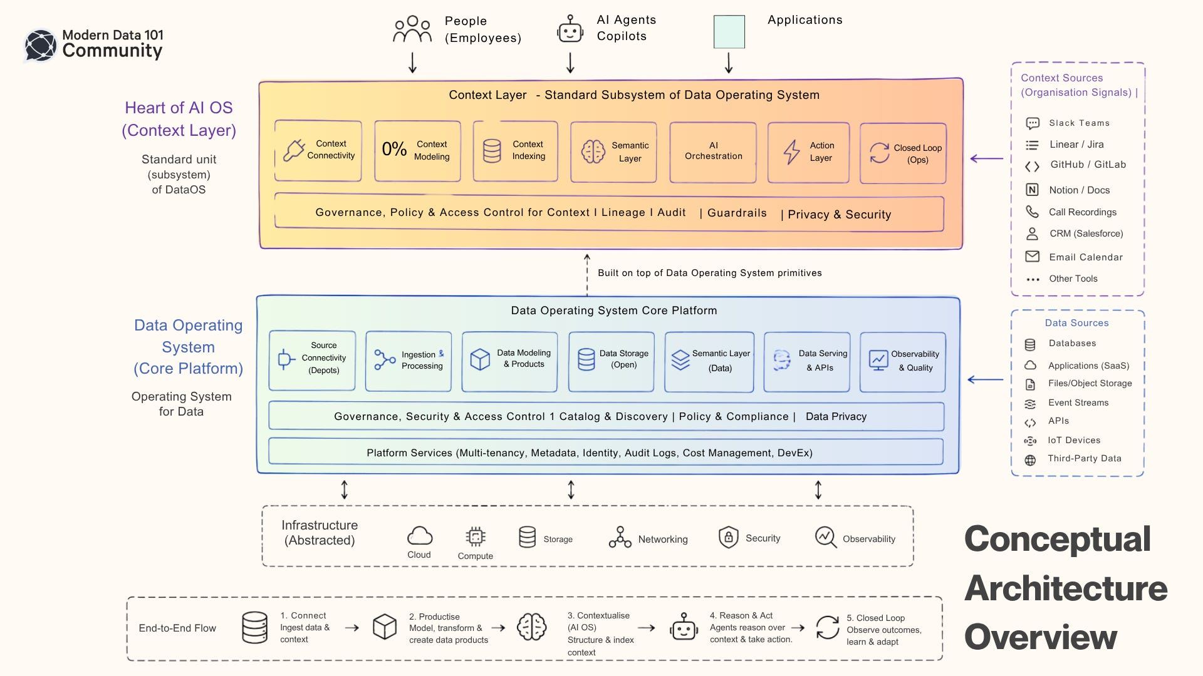

Slide 37
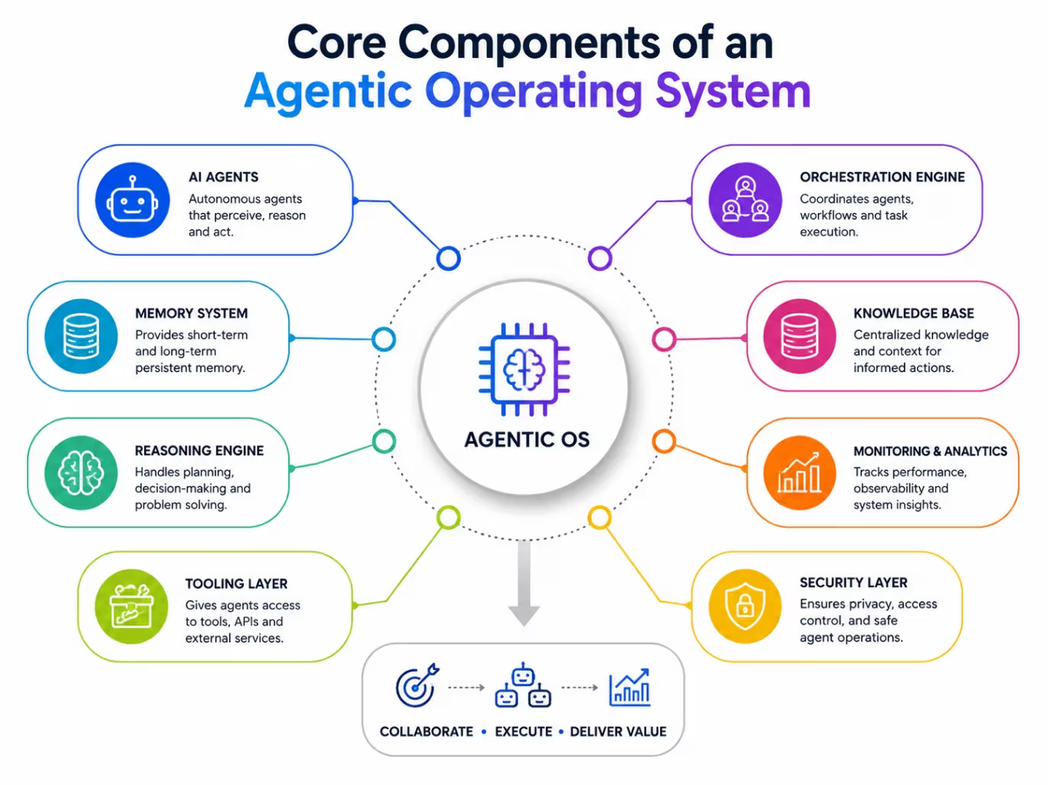

Slide 38
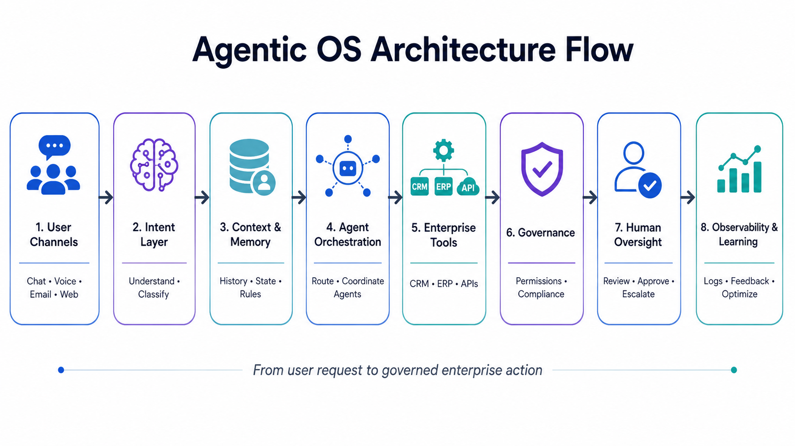

Slide 39
AGENT OS · BUILDING BLOCKS
The 8 building blocks
Every agentic OS is built from these parts. Each one maps to something a good company already has.
01
Constitution
02
Contracts
03
Workers
04
Verifiers
Rules the model can never break, in a CLAUDE.md / AGENTS.md file.
Each job is a work order: scope, inputs, expected output.
Cheaper, faster models that do the actual work.
Separate checkers that test and grade every result.
like the employee handbook
like a ticket with acceptance criteria
like the delivery team
like QA and code review
05
Trust ledger
06
Standing goals
07
Budget router
08
Improvement loops
Tracks scores. A good record earns more freedom.
Goals that never expire, re-checked every day.
Sends each job to the cheapest model that can do it.
Optional loops that learn from wins and failures.
like probation, then promotion
like KPIs and SLAs
like the finance manager
like sprint retrospectives
Coming up in the repos: AGENTS.md (constitution), Spec Kit (contracts), promptfoo (verifiers), claude-mem (memory).
Day 1 · AI in 2026 · 37
Notes:
Ask the room to match each block to a role in their own team. Verifiers is highlighted because it is the one rule that matters most (next slide).

Slide 40
AGENT OS · THE ONE RULE
Never let AI grade its own homework
If the same model does the work and checks it, it will happily approve its own mistakes.
✕ THE OLD WAY
✓ THE AGENTIC OS WAY
Worker
does the work
Worker
does the work
Verifier
a different model checks it
Grades itself
“looks great to me!”
Trust ledger
records the score
Ships
bugs slip through
Gate
plain code decides: tests, lint, build
Self-checking is the #1 reason agents ship broken work.
Four separate parties: conductor plans · worker does · verifier checks · gate decides. The last one is not AI at all.
Day 1 · AI in 2026 · 38
Notes:
Analogy: a student never marks their own exam. The gate is deterministic code (tests, type checks, linters) so the final yes/no can't be talked into anything. Link to promptfoo later in the deck.

Slide 41
AGENT OS · THE LOOP
The loop that makes it better every run
Every run leaves a lesson behind, so the next run starts smarter.
memory/lessons.md
1
Goal
what needs doing?
# 2026-10-30 · Refactor invoice API
result: pass confidence: 92%
evidence: 48 tests pass, lint clean
lesson: date validation missed an edge case
next time: run the date tests first
Retry
do better next time
6
2
Work
do it with the right tools
Better
every run
Save
write it to memory
5
3
Verify
independent check
4
Learn
what went right or wrong
YOUR TURN · 3 MINUTES
Which 2 of the 8 blocks would your use case need first — and why?
Nothing that passed once goes unwatched. Every success becomes a check that runs again tomorrow.
Day 1 · AI in 2026 · 39
Notes:
Goal → Work → Verify → Learn → Save → Retry. The memory note is what a lesson looks like in practice. Run the 3-minute exercise with the use-case pool; take 2–3 answers.

Slide 42




12
GitHub repos
built for the
agent era
Free & open source
Run them yourself
Readable source
Each one fixes a problem from the last slide. Stars observed 5 Oct 2026.
Day 1 · AI in 2026 · 40

Slide 43

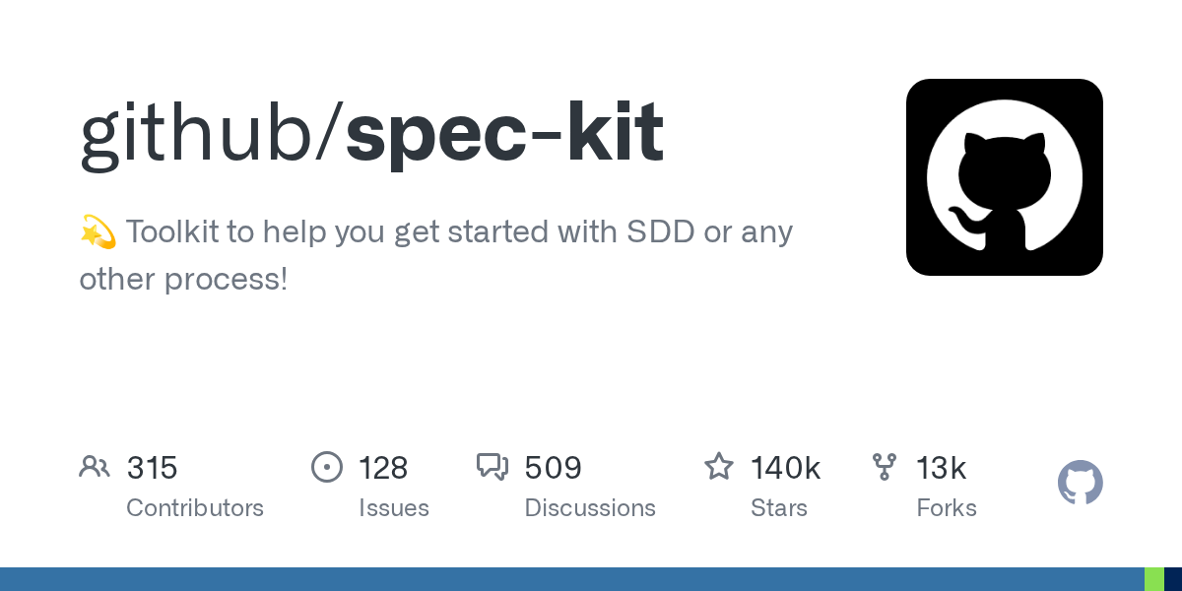




Repo 1
Fixes: Solving the wrong problem
Spec Kit
What it does
Specs first. Code second.
A CLI and templates that take an idea through principles → spec → plan → tasks, which your coding agent then implements and checks against.
What it replaces
Vibe-coding features straight from a chat prompt, with the real intent scattered across chat history.
github.com/github/spec-kit
140k stars · MIT
SWIPE →
Notes:
Spec Kit — https://github.com/github/spec-kit. Stars 140k observed 5 Oct 2026 via GitHub API; licence MIT. Ask the room: who has hit the problem this replaces?

Slide 44
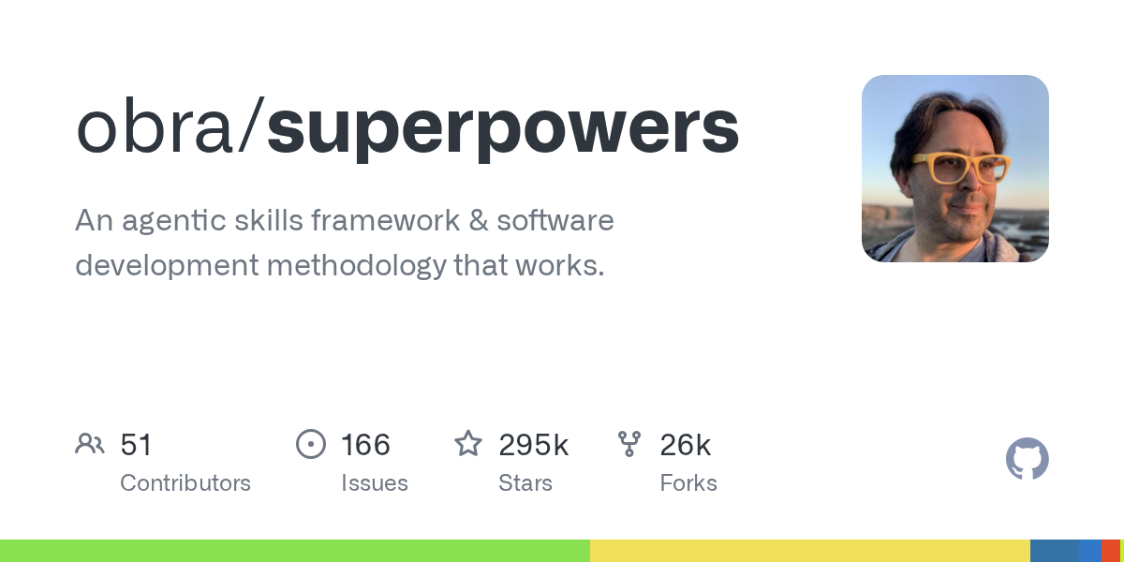
Repo 2
Fixes: Solving the wrong problem
Superpowers
What it does
A methodology your agent actually follows.
A skills library that makes the agent brainstorm, write a plan, then implement test-first and review — by default, not by request.
What it replaces
Hoping the agent plans and writes tests because you asked nicely in the prompt.
github.com/obra/superpowers
295k stars · MIT
SWIPE →
Notes:
Superpowers — https://github.com/obra/superpowers. Stars 295k observed 5 Oct 2026 via GitHub API; licence MIT. Ask the room: who has hit the problem this replaces?

Slide 45
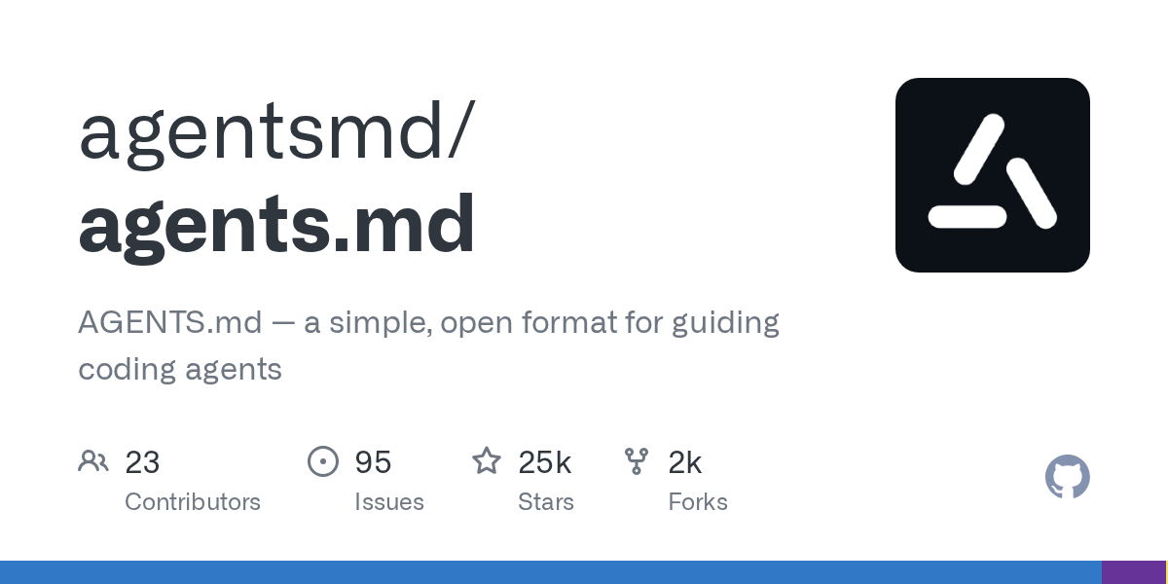
Repo 3
Fixes: Conventions forgotten
AGENTS.md
What it does
One README, written for your agents.
An open format for project instructions — commands, conventions, "do not" rules — read at the start of every session by most major coding agents.
What it replaces
Re-typing conventions in every chat, and a different rules file for every tool.
github.com/agentsmd/agents.md
25k stars · MIT
SWIPE →
Notes:
AGENTS.md — https://github.com/agentsmd/agents.md. Stars 25k observed 5 Oct 2026 via GitHub API; licence MIT. Ask the room: who has hit the problem this replaces?

Slide 46
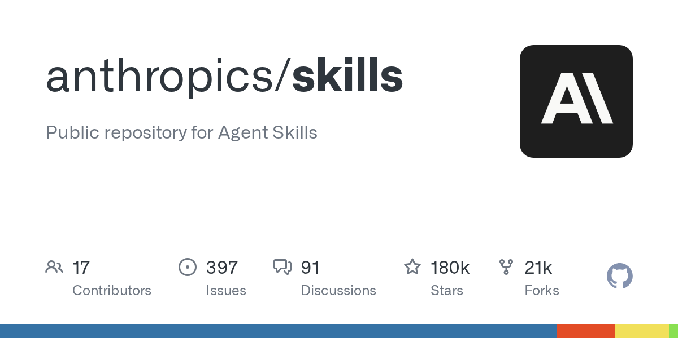
Repo 4
Fixes: Conventions forgotten
Agent Skills
What it does
Teach your agent a procedure once.
The reference spec and examples for skills: folders with a SKILL.md and scripts that load only when a task needs them.
What it replaces
Giant system prompts stuffed with every procedure, burning context on every single run.
github.com/anthropics/skills
180k stars · Per skill
SWIPE →
Notes:
Agent Skills — https://github.com/anthropics/skills. Stars 180k observed 5 Oct 2026 via GitHub API; licence Per skill. Ask the room: who has hit the problem this replaces?

Slide 47
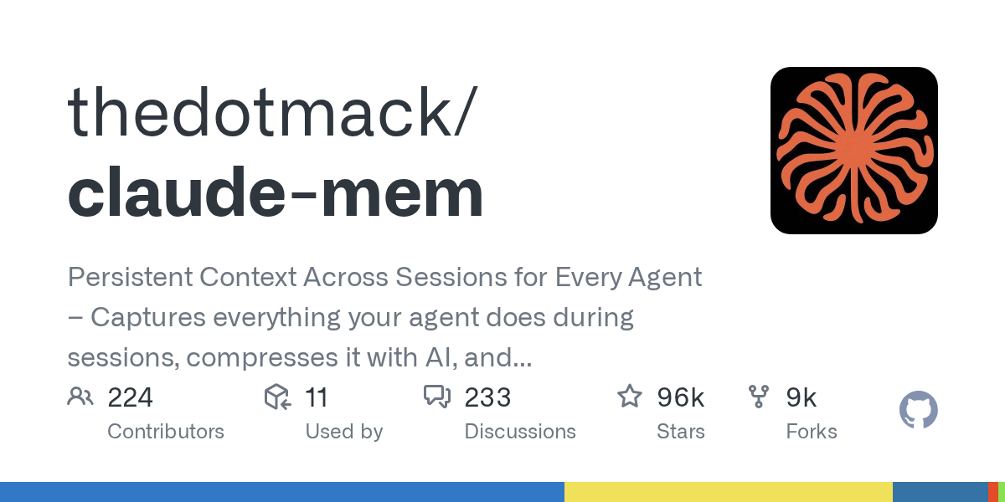
Repo 5
Fixes: Context rot & amnesia
claude-mem
What it does
Your agent finally remembers yesterday.
Captures what your agent did in each session, compresses it, and injects the relevant parts back in next time.
What it replaces
Session-based agents that reset to zero and need the whole project re-explained.
github.com/thedotmack/claude-mem
96k stars · Apache-2.0
SWIPE →
Notes:
claude-mem — https://github.com/thedotmack/claude-mem. Stars 96k observed 5 Oct 2026 via GitHub API; licence Apache-2.0. Ask the room: who has hit the problem this replaces?

Slide 48
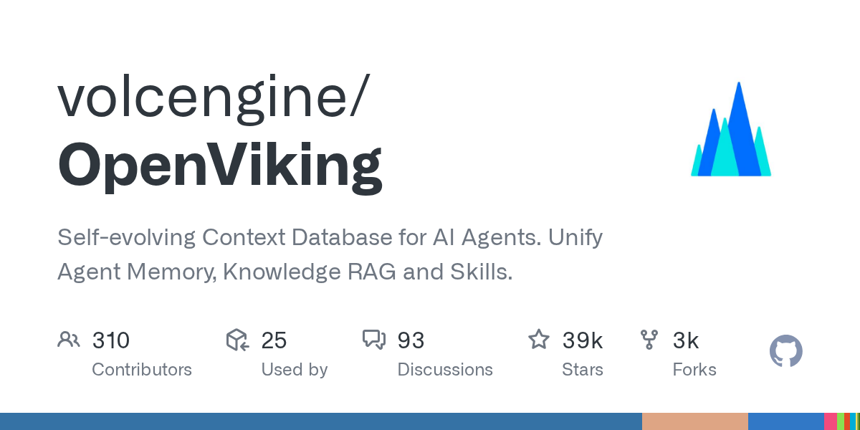
Repo 6
Fixes: Context rot & amnesia
OpenViking
What it does
One database for memory, knowledge and skills.
A context database that exposes agent memory, RAG knowledge and skills as one filesystem, loading summaries first and full detail only when needed.
What it replaces
Separate memory stores, vector DBs and skill configs that never stay in sync.
github.com/volcengine/OpenViking
39k stars · AGPL-3.0
SWIPE →
Notes:
OpenViking — https://github.com/volcengine/OpenViking. Stars 39k observed 5 Oct 2026 via GitHub API; licence AGPL-3.0. AGPL: fine to study and run, but get legal advice before embedding in client products. Ask the room: who has hit the problem this replaces?

Slide 49
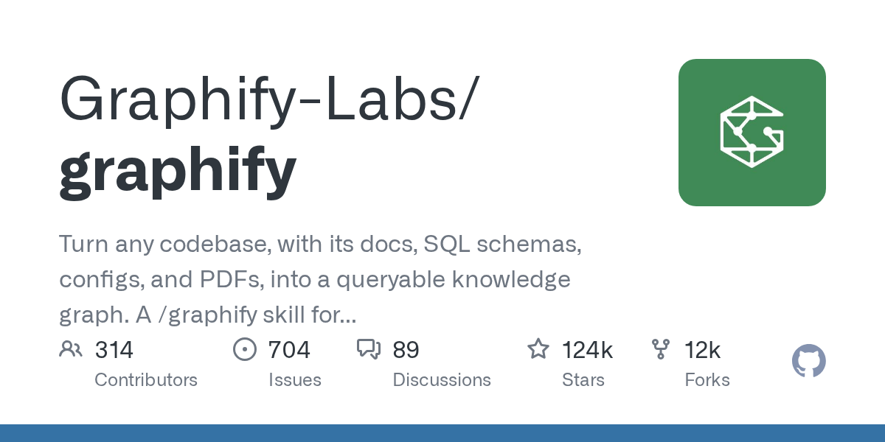
Repo 7
Fixes: Agent doesn't get the codebase
Graphify
What it does
Your codebase as a knowledge graph.
Turns a codebase plus its docs, SQL schemas, configs and PDFs into a queryable knowledge graph your coding agent can navigate.
What it replaces
Agents grepping blindly through files and missing cross-module dependencies.
github.com/Graphify-Labs/graphify
124k stars · Apache-2.0
SWIPE →
Notes:
Graphify — https://github.com/Graphify-Labs/graphify. Stars 124k observed 5 Oct 2026 via GitHub API; licence Apache-2.0. Ask the room: who has hit the problem this replaces?

Slide 50
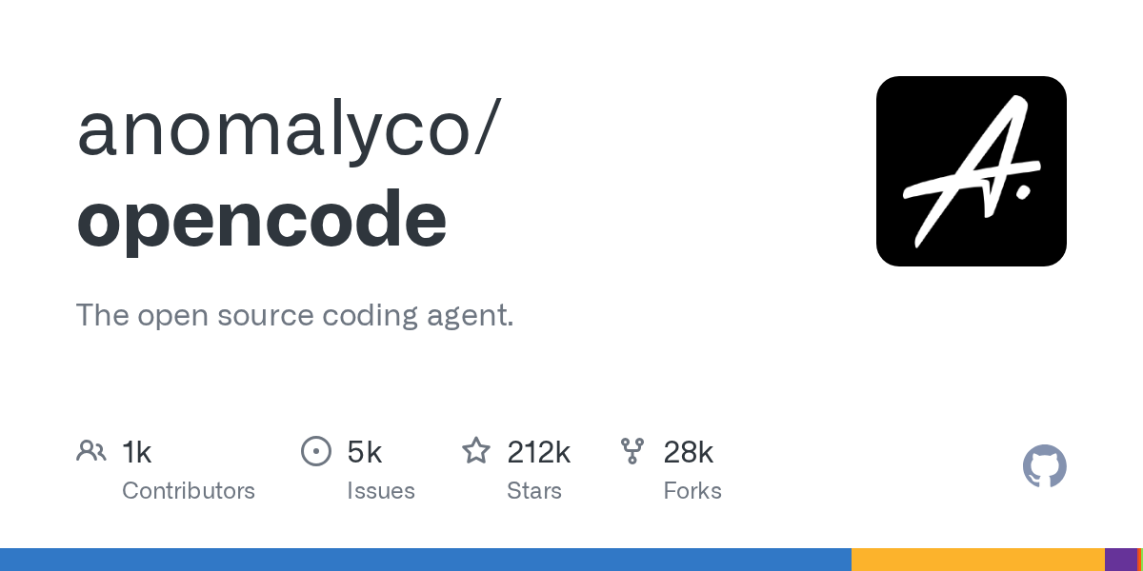
Repo 8
Fixes: Understand the loop
opencode
What it does
The open-source coding agent.
A terminal coding agent that works with any model provider — and readable source showing its loop, permissions and context compaction.
What it replaces
Black-box agents you can't inspect, locked to one vendor's models.
github.com/anomalyco/opencode
212k stars · MIT
SWIPE →
Notes:
opencode — https://github.com/anomalyco/opencode. Stars 212k observed 5 Oct 2026 via GitHub API; licence MIT. Ask the room: who has hit the problem this replaces?

Slide 51
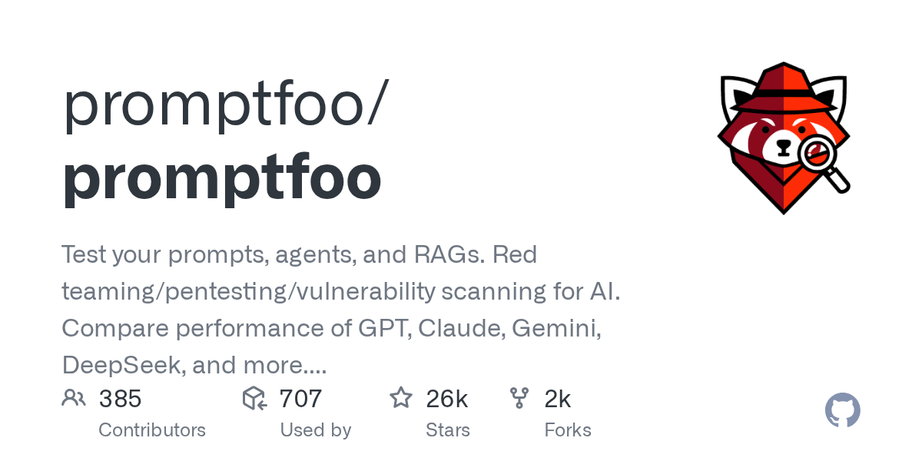
Repo 9
Fixes: Almost-right output
promptfoo
What it does
Unit tests for prompts and agents.
Declarative evals and red-teaming for prompts, agents and RAG; compares models side by side and runs in CI.
What it replaces
Eyeballing a few outputs and shipping on vibes.
github.com/promptfoo/promptfoo
26k stars · MIT
SWIPE →
Notes:
promptfoo — https://github.com/promptfoo/promptfoo. Stars 26k observed 5 Oct 2026 via GitHub API; licence MIT. Ask the room: who has hit the problem this replaces?

Slide 52
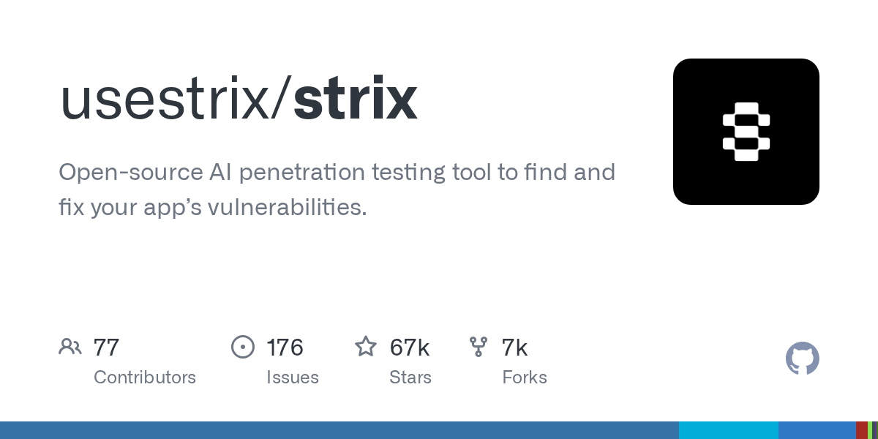
Repo 10
Fixes: Insecure code
Strix
What it does
An AI pentester for your app.
Teams of autonomous agents probe your app in a Docker sandbox and confirm each vulnerability with a working proof of concept.
What it replaces
Waiting for a yearly manual pentest while AI writes new code every day.
github.com/usestrix/strix
67k stars · Apache-2.0
SWIPE →
Notes:
Strix — https://github.com/usestrix/strix. Stars 67k observed 5 Oct 2026 via GitHub API; licence Apache-2.0. Only ever point it at apps we own, in a sandbox, with written scope. Ask the room: who has hit the problem this replaces?

Slide 53
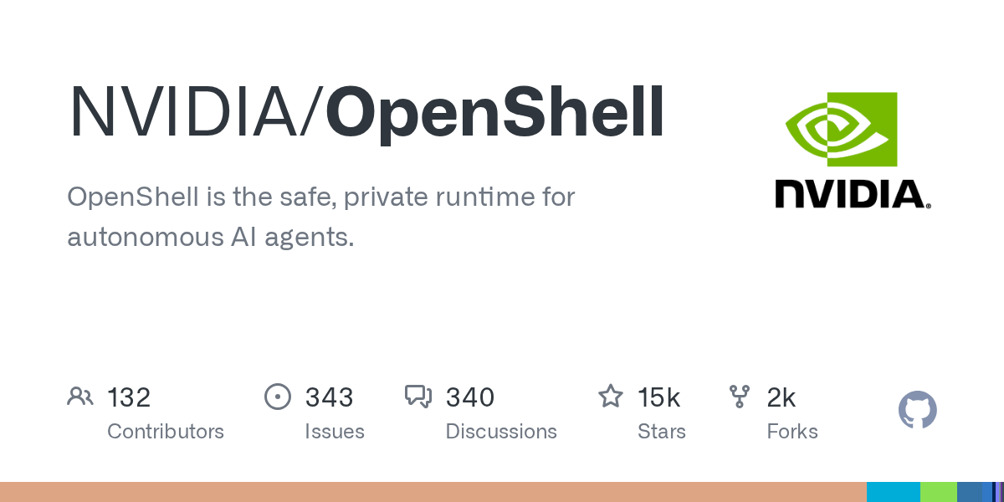
Repo 11
Fixes: Agents with too much power
OpenShell
What it does
A safe runtime for autonomous agents.
A sandboxed, private runtime that limits what an autonomous agent can reach while it works.
What it replaces
Running agents with your full user permissions — and your production credentials — on your laptop.
github.com/NVIDIA/OpenShell
15k stars · Apache-2.0
SWIPE →
Notes:
OpenShell — https://github.com/NVIDIA/OpenShell. Stars 15k observed 5 Oct 2026 via GitHub API; licence Apache-2.0. Ask the room: who has hit the problem this replaces?

Slide 54
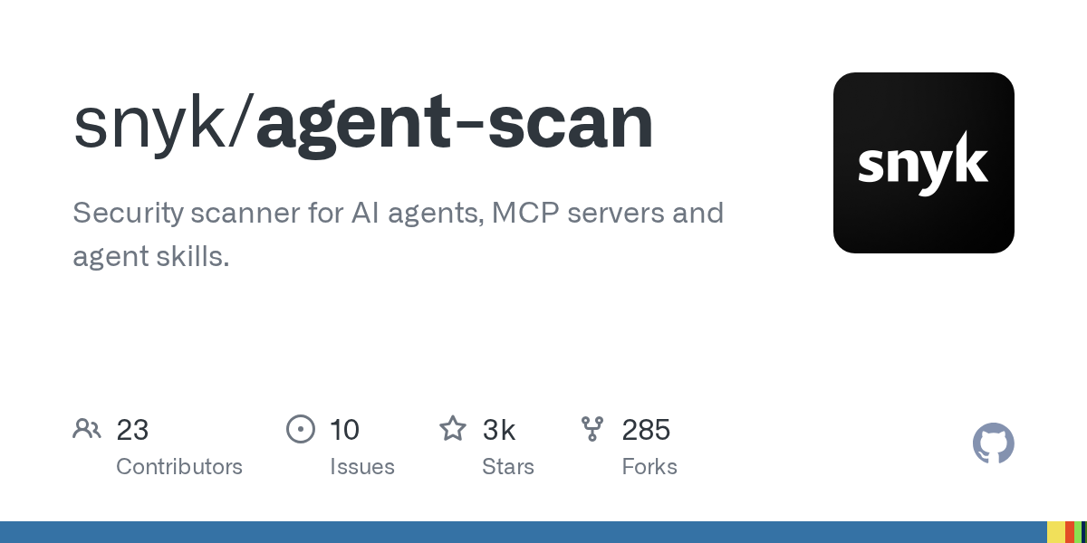
Repo 12
Fixes: Poisoned supply chain
agent-scan
What it does
Scan your agent's tools before they bite.
Scans MCP servers, agent configs and skills for tool poisoning, rug pulls and toxic data flows.
What it replaces
Installing MCP servers and skills from the internet on trust.
github.com/snyk/agent-scan
3k stars · Apache-2.0
SWIPE →
Notes:
agent-scan — https://github.com/snyk/agent-scan. Stars 3k observed 5 Oct 2026 via GitHub API; licence Apache-2.0. Ask the room: who has hit the problem this replaces?

Slide 55
PRACTICAL GUIDELINE
Read any codebase in 10 minutes
Swap one word in a GitHub URL. Then verify every claim against the code.
GitDiagram
github.com → gitdiagram.com
Interactive architecture diagram
DeepWiki
github.com → deepwiki.com
Generated wiki + Q&A; free MCP server for your agent
gitingest
github.com → gitingest.com
Whole repo as one LLM-ready text file
Repomix
npx repomix
Pack a local repo with token counts
GitReverse
github.com → gitreverse.com
The prompt that would rebuild the repo
Rule: diagram and summary tools read mostly the file tree and README — mark each claim verified, wrong or missing.
Day 1 · AI in 2026 · 53
Notes:
Spotting where an AI summary of code is wrong is the same skill as reviewing agent-written PRs. Demo live: swap github.com to gitdiagram.com on one of the repos above.

Slide 56
HANDS-ON LAB · 30 MIN
Pick one track. Work in pairs.
Deliverable: 3 lines in your agent log — what you tried, what the agent got wrong, how you verified.
A · Spec first
B · Codebase X-ray
C · Break it
Run Spec Kit on one small feature in your own repo. Then vibe-code the same feature. Compare the two diffs.
Map a repo you don't know with Graphify or GitDiagram + DeepWiki. Mark 10 claims verified / wrong / missing.
Write 10 promptfoo test cases for a prompt you use at work, including 3 injection attempts. Or scan your MCP config with agent-scan.
github.com/github/spec-kit
github.com/Graphify-Labs/graphify
github.com/promptfoo/promptfoo
Day 1 · AI in 2026 · 54
Notes:
Timing: 5 min setup, 20 min work, 5 min write-up. Two pairs share out. Strix is deliberately excluded from today's lab: offensive tools only against sandboxed targets we own (Week 7).

Slide 57



OUR GUIDELINES
How we use AI & GenAI at CodingCops
1
2
3
4
Verify before you ship
Spec before code
One task, one session
No secrets, no client data
Tests and evals gate every agent change.
Plan mode or a spec for anything that ships.
Clear context; carry a summary, not the transcript.
Approved tools and mock data only.
5
6
7
8
Read every diff
Least privilege
Vet what you install
Log the agent
You own every line the agent writes.
Sandbox agents; no prod credentials; approve destructive actions.
Packages, MCP servers, skills: check they exist, pin, scan.
Where it helped, where it was wrong, how you verified.
Day 1 · AI in 2026 · 55
Notes:
These map one-to-one to the challenges and to the program rubric (verification D4, spec & context D2, safety D5). Ask the room which rule they break most often.

Slide 58

PROBLEM FRAMING
Five questions before any design
Who is the user?
The specific person or role, and what they do today without the system.
What is the pain?
The measurable cost of the current way: time, errors, money, frustration.
What does success look like?
One primary metric with a target, e.g. first response under 5 min for 80% of tickets.
What does a wrong answer cost?
Annoyance, lost money, legal exposure, safety. This sets how much autonomy is acceptable.
What must a human approve?
Irreversible, expensive or customer-facing actions stay behind human sign-off.
Day 1 · AI in 2026 · 56
Notes:
This canvas is the template for A0 — and for framing your own industry use case. Encourage people to argue with the request itself.

Slide 59
WORKED EXAMPLE
"Auto-reply to all customer emails"
Taken literally
Framed properly
Agent replies to every email automatically
No metric beyond 'emails answered'
Wrong answers go straight to customers
Refund and legal emails treated like FAQs
Real pain: slow first response on repetitive questions
Metric: first response under 5 minutes on FAQ-type emails
Classify first; auto-reply only to low-risk categories
Draft, don't send, for billing, refunds and complaints
Same request, very different system: a classifier plus drafts with approval — not a fully autonomous agent.
Day 1 · AI in 2026 · 57
Notes:
Run as a 10-minute group exercise before revealing the right column.

Slide 60
YOUR BUILD
Use-case pool from our portfolio (1/2)
From the 10 sectors we deliver in · 13 picks + 3 reserves · ★ = GenAI whitespace
1
HEALTHCARE · HEDIS QUALITY
Coworker
2
HEALTHCARE · TELEHEALTH
Ambient
Care-gap closer ★
Patient-message triage ★
Finds open quality-measure gaps in claims and records, drafts outreach and evidence packs; a clinician approves.
Sorts portal messages by urgency with a classifier, routes them, drafts replies; never diagnoses.
3
FINANCIAL SERVICES · LENDING
Coworker
4
INSURANCE · CLAIMS INTAKE
Ambient
Loan-file prep agent
Claims triage agent
Collects documents, checks lending policy, flags gaps and drafts the underwriter memo with a risk score.
Classifies new claims, scores fraud risk with an ML model, requests missing documents; adjuster decides.
5
CONSTRUCTION · SCHEDULING
Ambient
6
ENERGY · POWER MARKETS
Assistant
Schedule-risk watcher
Forecast analyst copilot
Watches schedule and field updates, predicts delays, proposes re-sequencing for the PM to approve.
Explains load and price forecasts from an ML model and drafts the daily trading-desk brief.
7
REAL ESTATE · CRE INTELLIGENCE
Coworker
8
ENTERPRISE IT · HELP DESK
Ambient
Due-diligence coworker
L1 IT support agent
Compiles leases, comps and risk flags for a property into a cited investment memo.
Triages tickets, auto-resolves low-risk requests, escalates the rest with diagnostics attached.
Day 1 · AI in 2026 · 58
Notes:
Source: CodingCops Portfolio Hub (snapshot 1 Oct 2026), 10 sectors / 47 projects. Use cases are modelled on sub-industries where we have delivered work; client names omitted because several projects are confidential. ★ marks sectors with no GenAI project yet (Healthcare, Automotive) — building these creates new case-study material. Full briefs: 'Industry Agentic Use-Case Pool' doc in 00 · Program Overview. Every use case includes a human-approval step and an ML component (rubric D8).

Slide 61
YOUR BUILD
Use-case pool from our portfolio (2/2)
Each grows weekly: assistant → tools & data → coworker → ambient.
9
ENTERPRISE IT · AI GOVERNANCE
Coworker
10
BUSINESS OPS · PROCUREMENT
Coworker
Agent governance auditor
Negotiation prep coworker
Reviews agent traces and MCP configs against policy (OWASP Agentic Top 10) and files findings.
Compares supplier quotes and history, drafts a negotiation brief with target prices.
11
AUTOMOTIVE · DEALERSHIPS
Assistant
12
HOSPITALITY · DIRECT BOOKING
Ambient
Service-lane copilot ★
Guest message & offer agent
Answers from vehicle service history and suggests next services by propensity; advisor approves.
Answers guest enquiries and proposes personalised offers; discounts need approval.
13
MEDIA · AD CREATIVE OPS
Ambient
14
EDUCATION · ADMISSIONS
Reserve
Ad performance watcher
Admissions counsellor
Flags CPA/ROAS anomalies in daily ad data and proposes creative changes for approval.
Answers applicant questions from programme rules and tracks each applicant's progress.
15
GOVERNMENT · REENTRY SERVICES
Reserve
16
MANUFACTURING · B2B SALES
Reserve
Caseworker coworker
Product expert & quoting
Matches clients to housing and job options and drafts the case plan for a caseworker.
Answers technical product questions from manuals and drafts quotes for sales approval.
Day 1 · AI in 2026 · 59
Notes:
Source: CodingCops Portfolio Hub (snapshot 1 Oct 2026), 10 sectors / 47 projects. Use cases are modelled on sub-industries where we have delivered work; client names omitted because several projects are confidential. ★ marks sectors with no GenAI project yet (Healthcare, Automotive) — building these creates new case-study material. Full briefs: 'Industry Agentic Use-Case Pool' doc in 00 · Program Overview. Every use case includes a human-approval step and an ML component (rubric D8).

Slide 62
THE JOURNEY
8 weeks, one evolving system
OpsPilot is the shared example; your industry use case grows the same way.
Phase 1 · Evaluation (everyone)
Phase 2 · Continuation (selected)
W0
W1
W2
W3
W4
W5
W6
W7
W8
Frame the problem
Assistant built from a spec
Tools, MCP, data, memory, ML
Coworker: harness & evals
Ambient: guardrails & team build
Production & durability
Online evals & ML tools
Security, red-team & cost
Deliver & hand over
Assistant (human asks) → Coworker (human delegates) → Ambient (event triggers) → Production
Day 1 · AI in 2026 · 60
Notes:
Updated from the 4-week Week 0 slide. Week 4 decision: continue to Phase 2 if overall ≥70% and no dimension below 2.5.

Slide 63
ASSESSMENT
How you will be assessed
The rubric is public. Scores and rankings are confidential to program management.
D1
Problem framing
15%
70%
overall to continue after Week 4
D2
Spec & context
12%
D3
Architecture
18%
D4
Verification & evals
18%
2.5 / 5
minimum average on every dimension — GenAI and ML
D5
Safety & harness
10%
D6
Collaboration
8%
30%
of Phase 1 comes from live sessions, answered without the agent
D7
Reasoning
9%
D8
ML & data reasoning
10%
A working demo you cannot explain scores low.
Day 1 · AI in 2026 · 61
Notes:
Updated from the Week 0 deck: 8 dimensions (D8 ML & data reasoning added), weights per the current syllabus, live sessions 30%.

Slide 64


YOUR FIRST ASSIGNMENT
A0 · Problem framing memo
Due end of Week 0 · scored on D1 framing, D7 reasoning, D8 model judgment
1
2
3
Three requests
Frame each one
Your use case
Auto-reply to all customer emails · flag suspicious refunds · summarise weekly incidents for leadership
User, pain, metric, cost of a wrong answer, what a human approves — then: agent, workflow + LLM step, trained model, plain code, or no AI?
Frame your industry use case from the pool with the same canvas. This becomes your build for the next 4 weeks.
Two pages maximum. Submit to your folder in B · Submissions. Setup by Day 1: Python, a coding agent, API key, your submission folder.
Day 1 · AI in 2026 · 62
Notes:
Strong memos question the request (request 2 may be better served by rules plus a statistical model, with an LLM only for explanation). Common pitfall: recommending 'an agent' for all three.

Slide 65
DISCUSSION
Your turn
1
What is the most expensive "almost right" an agent has given you?
2
Which of the six problems costs our client projects the most today?
3
Which repo from today would you put in front of a client first — and which never?

